Slide 1

Software engineering (Undergraduate)
Chapter 4 agile software development
Course Name software engineering
CSC 3114
(Undergraduate)
Saikat Baul
Lecturer, CS, AIUB
saikatbaul@aiub.edu

Slide 2
What is an agile method?
Slide-2
Agile methods are considered
Lightweight (do not concentrate on the whole software development at once)
People-based rather than Plan-based
Several agile methods
No single agile method
Different agile methods can be combined in software development (Hybrid)
SB

Slide 3
Agile development
Slide-3
“Plan-driven methods work best when developers can determine the requirements in advance . . . and when the requirements remain relatively stable, with change rates on the order of one percent per month.”~ Barry Boehm
Companies need to
innovate better and faster operations
respond quickly to
competitive initiatives
new technology
customer's requirements
SB

Slide 4
Agile Model
Slide-4
Subset of iterative and evolutionary methods
Iterative Products
Each iteration is a self-contained, mini-project with activities that span requirements analysis, design, implementation, and test
Leads to an iteration release (which may be only an internal release) that integrates all software across the team and is a growing and evolving subset of the final system
The purpose of having short iterations is so that feedback from iterations N and earlier, and any other new information, can lead to refinement and requirements adaptation for iteration N + 1
SB

Slide 5
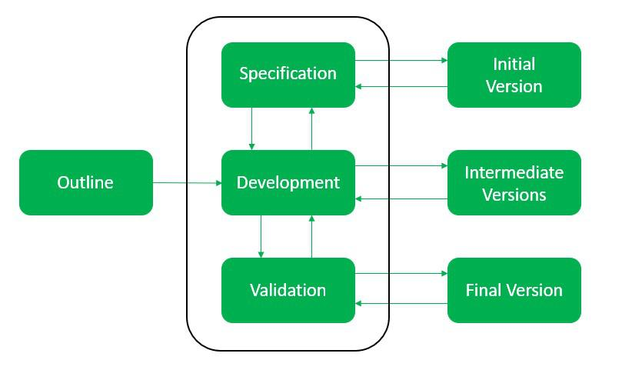
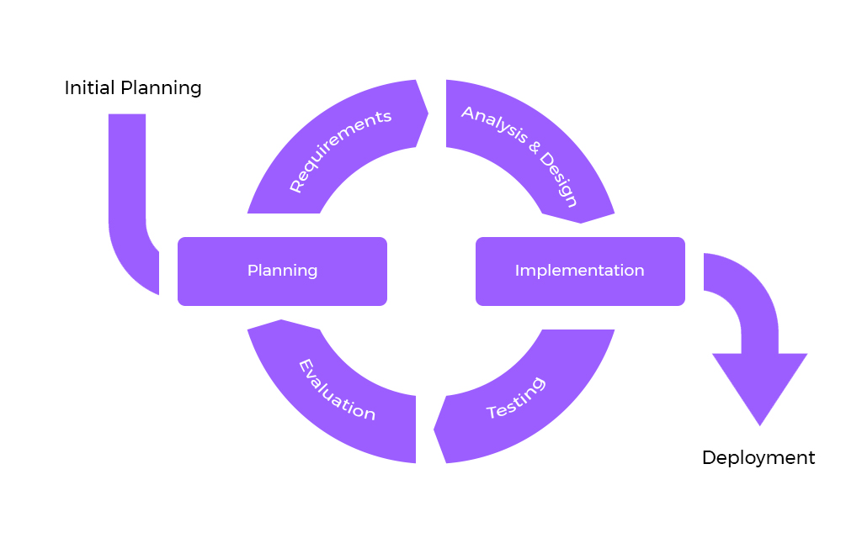
Evolutionary + Iterative Model = Agile

Slide 6
Agile methods vs. Past Iterative methods
Slide-6
A key difference between agile methods and past iterative methods is the length of each iteration.
In the past, iterations might have been three or six months long.
In agile methods, iteration lengths vary between one to four weeks and intentionally do not exceed 30 days.
Research has shown that shorter iterations have lower complexity and risk, better feedback, and higher productivity and success rates.
SB

Slide 7
Timebox & scope
Slide-7
The pre-determined iteration length serves as a timebox for the team.
Scope (set of tasks) is chosen for each iteration to fill the iteration length.
Rather than increase the iteration length to fit the chosen scope, the scope is reduced to fit the iteration length.
SB

Slide 8
Agile vs. Plan driven process
Slide-8
Agile Process | Plan Driven Process
Small products and teams; scalability limited | Large products and teams; hard to scale down
Inappropriate for safety-critical products because of frequent changes | Handles highly critical products
Good for dynamic, but expensive for stable environments. | Good for stable, but expensive for dynamic environments
Require experienced Agile personnel throughout | Require experienced personnel only at start if stable environment
Personnel succeed on freedom and chaos | Personnel succeed on structure and order
SB

Slide 9
Agile assumption
Slide-9
It is difficult to predict in advance which software
requirements will persist and which will change
It is equally difficult to predict how customer priorities will change as the project proceeds
Design and construction are interleaved in many types of software. That is, both activities should be performed tightly so that design models are proven as they are created. It is difficult to predict how much design is necessary before construction is used to prove the design.
Analysis, design, construction, and testing are not as predictable (from a planning point of view) as we might like.
SB

Slide 10
Human factors in agile development
Slide-10
Skill / Capability
Common focus
Collaboration
Decision-making ability
Fuzzy problem-solving ability
Mutual trust and respect
Self-organization
SB

Slide 11
Agile methods
Slide-11
Extreme Programming (XP)
Scrum
Dynamic Systems Development Method (DSDM)
Feature-Driven Development (FDD)
Crystal Methods
Lean Development (LD)
Adaptive Software Development (ASD)
SB

Slide 12
references
Slide - 15
R.S. Pressman & Associates, Inc. (2010). Software Engineering: A Practitioner’s Approach.
Kelly, J. C., Sherif, J. S., & Hops, J. (1992). An analysis of defect densities found during software inspections. Journal of Systems and Software, 17(2), 111-117.
Bhandari, I., Halliday, M. J., Chaar, J., Chillarege, R., Jones, K., Atkinson, J. S., & Yonezawa, M. (1994). In-process improvement through defect data interpretation. IBM Systems Journal, 33(1), 182-214.
SB

